Slide 1
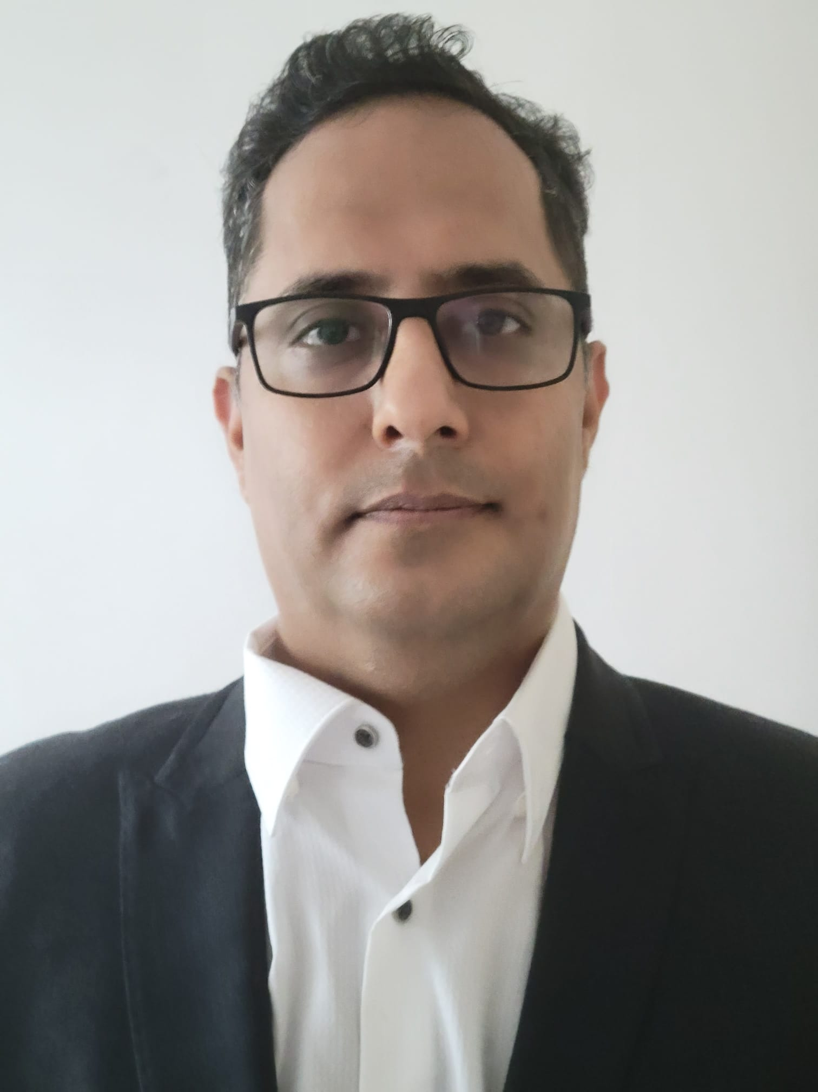



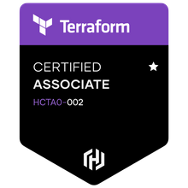



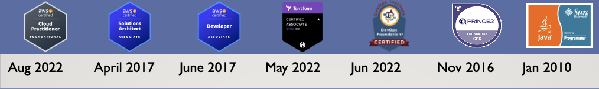

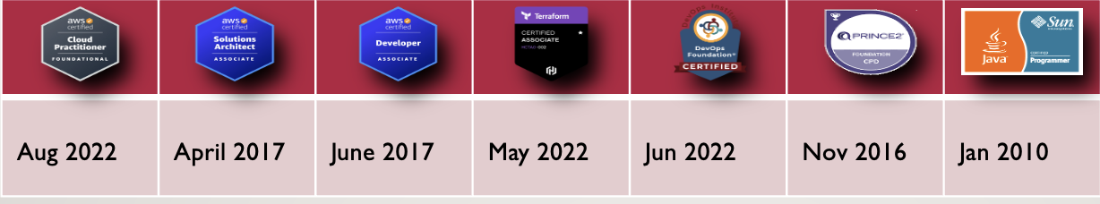
Mayank Chugh
Aug 2022 | April 2017 | June 2017 | May 2022 | Jun 2022 | Nov 2016 | Jan 2010
Senior Technical Manager (Cloud + Application)
LinkedIn: www.linkedin.com/in/mchugh44
Git: https://github.com/mayankchugh1977
Project Portfolio:
Cloud - https://eportfolio.mygreatlearning.com/mayank-chugh
AI & ML - https://eportfolio.mygreatlearning.com/mayank-chugh2
Contact:
Email: mayankchugh.jobathk@gmail.com
Mobile: +852 84812040

Slide 2
Mayank Chugh
Email: mayankchugh.jobathk@gmail.com
Mobile: +852 84812040
ç
LinkedIn: www.linkedin.com/in/mchugh44
Git: https://github.com/mayankchugh1977
Senior Technical Manager
(Cloud + Application)

Slide 5
Agenda
Intro
Skills (Key + Technical)
Professional Experience
Education (Academic + Professional)
Q & A

Slide 6
Intro
Hands-on solution-driven IT professional with 18+ years of extensive experience as a consultant, solution architect, project manager, team lead, and senior engineer for multiple software development projects. Focus on pre-sales, product scoping & pricing, solution development, project management, release management, network engineering, and systems administration. Energetic and recognized for having excellent communication and problem-solving skills spanning multiple technical towers and global enterprises.

Slide 7
Key Skills
Technical Documentation Understanding
Solution Technical architecture (Application + Cloud)
System Migration/Integration • Quality Assurance
Project Lifecycle Management
Project Requirements Analysis
Custom Software Development and Database Design
Project Scheduling and Budgeting
Project Manager Supervision
Release Management
Technical Project planning
Build Technical Teams

Slide 8
Technical Skills
Languages: Java / J2EE, EJB, Spring Boot, JavaScript, ReactJS, Struts 1.x MVC, PL/SQL, Python
Databases: Oracle, MySql, Postgress; Reporting: iReport, Jasper Report; Version Control: GIT, SVN, VSS
Web Services: Soap, Rest API Development, Swagger API; Management Tool: Jira, Maximo, Bugzilla, Mantis
Operating Systems: Windows (XP, 10), Lunix and Ubuntu; Methodologies: Agile, Iterative, Waterfall Model
Cloud Services: AWS EC2, ELB, EBS, S3, VPC, SES, SNS, IAM, RDS, Cloud Watch, Cloud Front, AWS CLI, AWS IOT MQTT (pub/sub)
DevOps: GIT, Jenkins pipeline, AWS CI/CD pipeline, dockers, Ansible, AWS ECS and EKS cluster, Kubernetes(K8S), Terraform.
Machine Learning: Supervised Learning – Linear/Logistic Regression, Decision Tree, Random Forrest Tree

Slide 9
PROFESSIONAL EXPERIENCE
JOB Title: Cloud Application Manager Architect
Tenure: Mar ‘ 22 – Aug ’ 22 (6 Months)
Company: Deloitte, Hong Kong
Client: CHANEL
Participated in Pre-sales activity for providing High availability, Fault tolerant and resilience application to the client.
Contributing as SME for application implementation and Azure cloud for accepted SLA, RPO and RTO.
Working closely with delivery head, fellow Architects and other members for delivering complete IT solutions.
JOB Title: Cloud Architect – Senior Manager
Tenure: Oct ‘ 21 – Feb ’ 22 (5 Months)
Company: Capgemini, Hong Kong
Client: HSBC
Gathered project requirements for setting up application on Cloud through interactions, meetings, and walkthroughs with potential application users functional and non-requirements.
Server side API designing and Providing AWS architecture for setting up AWS EKS cluster having Jenkins CI/CD pipeline.

Slide 10
PROFESSIONAL EXPERIENCE
JOB Title: Senior Technical Architect
Tenure: May ‘ 04 – Oct ’ 21 (17 years 6 Months)
Company: Coforge, Erstwhile NIIT Technologies Limited, Hong Kong
Client: Cathay Pacific Cargo Terminal & Asia Airfreight Terminal
Gathered project requirements (150+ of AAT and 35+ of CPSL) through interactions, meetings, and walkthroughs with potential application users and develop business requirements documents (BRD), functional requirements documents (FRD), and user mockups. Also, I created 55+ technical responses to Requests for Quotes (RFQs) for customers.
I Provided winning solutions as part of the pre-sales team, which included responding to RFPs and RFIs from existing and prospective clients. Recently, involved in a proposal for the migration of Monolithic to cloud study. Conducted a few POCs for the same Participated in both pre-sales and post-sales activities, including establishing statements of work, responsibility matrixes, and overseeing the technical realization of solutions by delivery teams.
Worked closely with executive sales teams to deliver quotes and full IT solutions in networking, computing, storage, and virtual cloud infrastructure. Also, Designed and developed projects: On-premise Storage move to AWS, OCR using AI Computer vision, AWS IOT using MQTT (pub/sub) for controlling Cold Box for warehouse cargo application.
Monitor SLA and tested application performance to identify potential bottlenecks, develop solutions, and collaborate with developers on solution implementation for 5 Web, 3 Mobile applications. Provided 2nd and 3rd level technical support and troubleshooting to internal and external clients. Team Size - 4 - on-site resources, 4 - offshore resources.
Successfully managed multimillion-dollar revenue accounts including focus on several Completed 15.5K days of works. I have managing releases during all phases of software development life cycle, from requirements analysis through system implementation for more than 2 enterprises projects. Worked closely with customers, internal staff and other stakeholders to determine planning, implementation and integration of system-oriented projects. System development of RESTful API for having interface with HKIA.

Slide 11
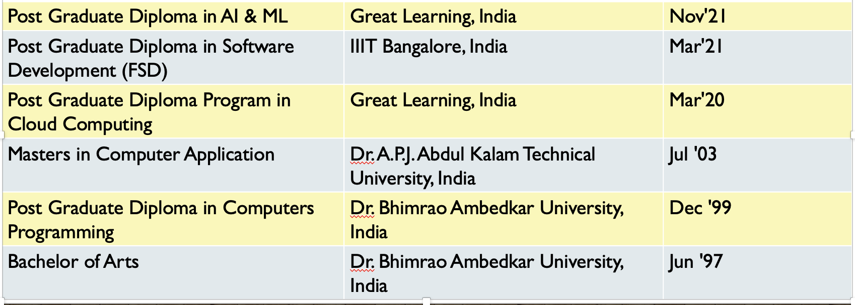
Academic Education
Stream | University / Institution | Year
Post Graduate Diploma in AI & ML | Great Learning, India | Nov'21
Post Graduate Diploma in Software Development (FSD) | IIIT Bangalore, India | Mar'21
Post Graduate Diploma Program in Cloud Computing | Great Learning, India | Mar'20
Masters in Computer Application | Dr. A.P.J. Abdul Kalam Technical University, India | Jul '03
Post Graduate Diploma in Computers Programming | Dr. Bhimrao Ambedkar University, India | Dec '99
Bachelor of Arts | Dr. Bhimrao Ambedkar University, India | Jun '97

Slide 12
Professional Certification
Certification | Issued Date
HashiCorp Certified: Terraform Associate | May 2022
DevOps Foundation Certified | Jun 2022
AWS Certified Cloud Practitioner | Aug 2022
AWS Certified Solutions Architect – Associate | April 2017
AWS Certified Developer – Associate | June 2017
PRINCE2® Foundation and Practitioner | Nov 2016
Sun Certified Java Professional (JDK 1.6) | Jan 2010

Slide 13

Q & A

Slide 14

Thank you!

Slide 15
The End

